Slide 1
The Relationship between Trauma & Resilience USING DATA TO DRIVE SYSTEM REPONSES TO VIOLENCE
Bryan Samuels, Commissioner Administration on Children, Youth and Families

Slide 2
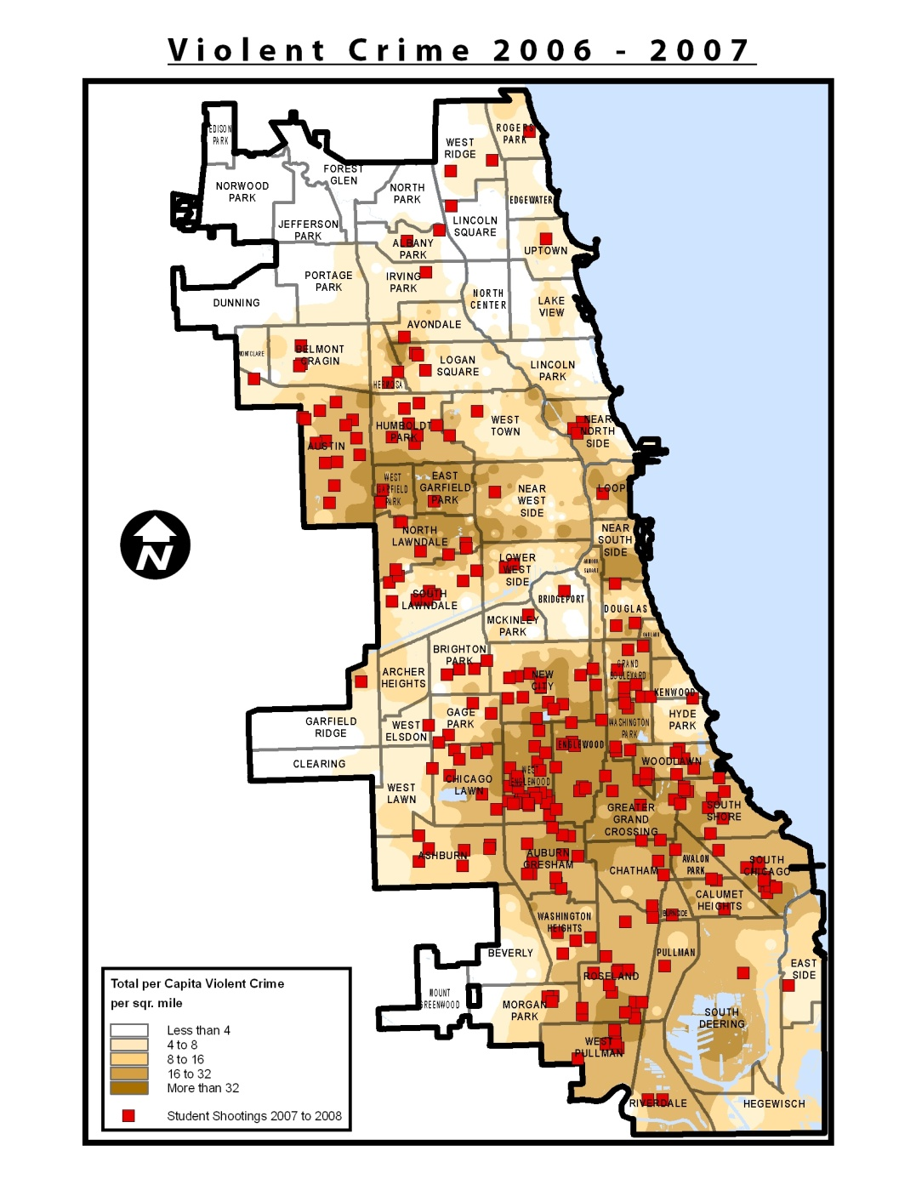
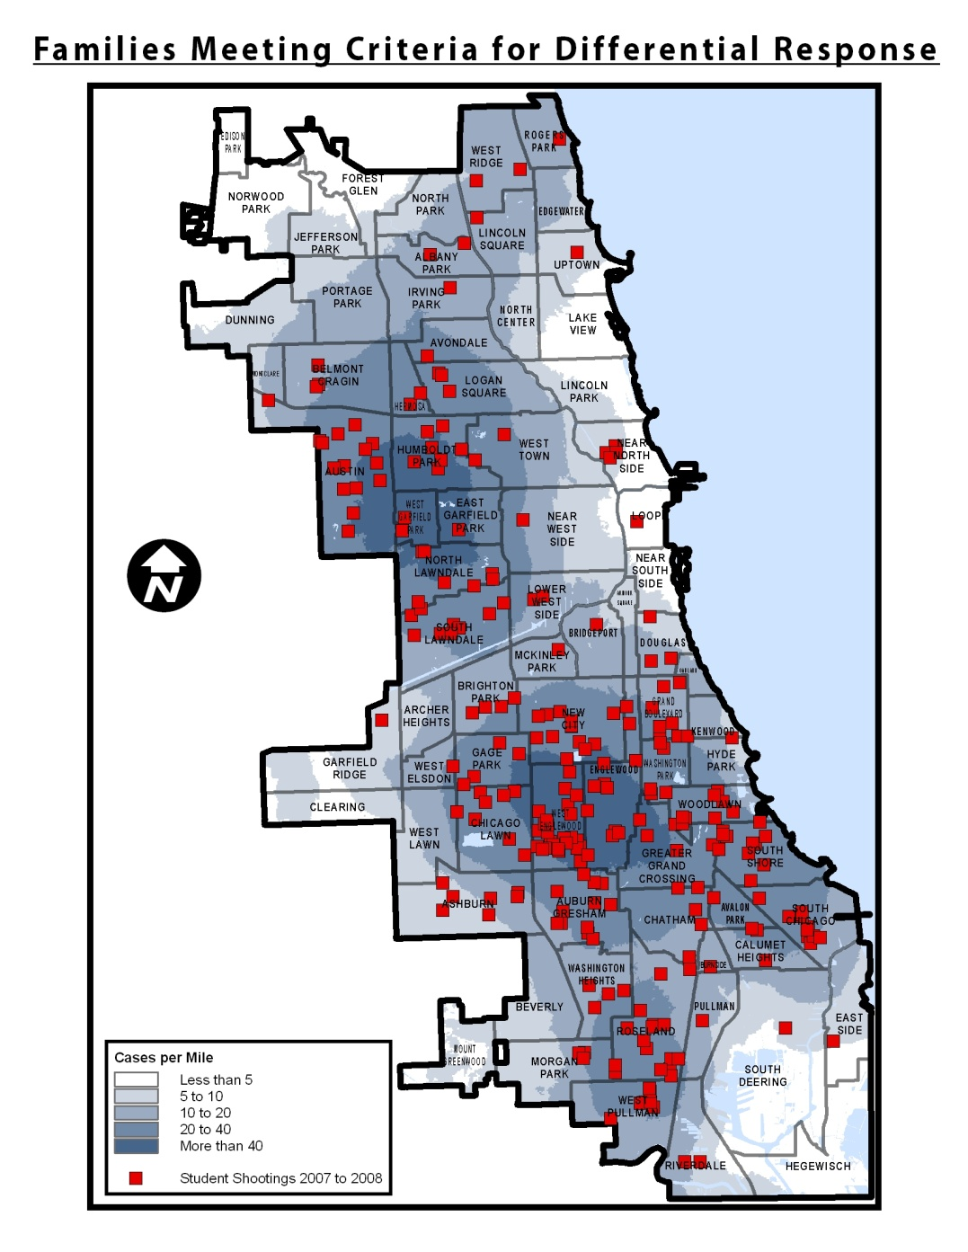
COMMUNITY VIOLENCE/STUDENT SHOOTING AND CHILD WELFARE CASES

Slide 3
Impact of Trauma on Development
The developmental stage of the child at the onset of traumatic exposure will influence the type and severity of the consequences.¹
Ongoing exposure to trauma can lead to chronically high or low levels of cortisol in the brain, associated with significant health problems and neurological damage later in life.²
The ability to develop secure attachments and form healthy relationships can be compromised by the impact of experiences of violence and trauma.³
The identification of emotions and the capacity to express and modulate them safely can become impaired in children and youth who have experienced complex trauma.
“Children who are unable to consistently regulate internal experience may turn to alternative strategies, including dissociative coping (e.g., chronic numbing of emotional experience), avoidance of affectively laden situations, including positive experiences, and/or use of behavioral strategies (e.g., substance use). Those children who are unable to find consistent strategies to assist them in modulation of emotion may present as emotionally labile, demonstrating extreme responses to minor stressors, with rapid escalation and difficulty self-soothing. ⁴”
IMPACTS:
How children understand their experiences
Whether developmental tasks are being achieved on schedule
How children cope with adverse experiences
The availability of supports to buffer against negative outcomes
Frederico, MM; Jackson, AL; & Black, CM. (2005). Reflections on Complexity: The 2004 Summary Evaluation of Take Two. Bundoora, Victoria: School of Social Work and Social Policy, La Trobe University.
Perry BD; Pollard RA; Blakely TL; Baker WL; & Vigilante D. (1995). Childhood trauma, the neurobiology of adaptation and use‐dependent development of the brain: How ‘states’ become ‘traits.’ Infant Mental Health Journal. 16:271‐291.
Cook, A, Blaustein; M, Spinazzola, J; & van der Kolk, B. (Eds.). (2003). Complex Trauma in Children and Adolescents: White Paper from the National Child Traumatic Stress Network Complex Trauma Task Force. Substance Abuse and Mental Health Services Administration (SAMHSA, USDHHS).
Ibid.

Slide 4
Lessons Learned about Resilience
Resilience is not a single trait or process—many attributes and processes are involved.
There are multiple pathways to resilience.
It is easy to make the mistake of blaming the victim when resilience does not occur, if one assumes that resilience arises only from internal capacities.
The evidence strongly implicates the roles of transactional processes and adaptive capacity arising external to the organism in resilience.
There are no magic bullets for producing resilience.
There are no invulnerable children.
There are levels of risk and adversity so overwhelming that resilience does not occur and recovery is extraordinarily rare or impossible.
Masten, AS & Obradović, J. (2006). Competence and resilience in development. Resilience in Children. 1094:13.

Slide 5
Promoting Well-Being
Dimensions through which experiences of trauma and violence impact children in the short- and long-terms
Protective mechanisms can serve in multiple functions; what is important is how they contribute to healing and recovery
Protective Mechanisms
Understanding Experiences: Dimensions through which experiences of trauma and violence impact children in the short- and long-terms
Protective Mechanisms: Protective mechanisms can serve in multiple functions; what is important is how they contribute to healing and recovery
Healing & Recovery: Locus of interventions to promote social and emotional functioning to facilitate healing and recovery
Understanding Experiences
Developmental Tasks
& RECOVERY
HEALING
Social and Emotional Well-Being
Coping Strategies
Environmental Buffers
Protective Mechanisms
Locus of interventions to promote social and emotional functioning to facilitate healing and recovery
Notes:
Dimensions adapted from Finkelhor, D & Kendall-Tacket, K (1997). “A developmental perspective on the childhood impact of crime, abuse, and violent victimization. In D. Cicchetti & S. Toth (Eds.), Developmental Perspectives on Trauma: Theory, Research, and Intervention (pp. 1-32). New York: University of Rochester Press.

Slide 6
Promoting Resilience
Domains/Constructs | Indicators
Self-management | Age-appropriate autonomy, emotional self-regulation, persistence, constructive time use
Agency | Planfulness, resourcefulness, positive risk-taking, realistic goal-setting, motivation
Sense of purpose | Believing one’s life is meaningfully connected to a larger picture
Confidence | Positive identity and self-worth
Social Intelligence | Communication, cooperation, conflict-resolution skills, trust, intimacy
Adapted from: Lippman, LH; Moore, KA & McIntosh, H. (2011). Positive indicators of child well-being: A conceptual framework, measures, and methodological issues. Applied Research in Quality of Life. Accessed on August 16, 2011. http://www.springerlink.com.proxy.uchicago.edu/content/tr32721263478297/.
Notes:
This Table shows the relationship between Domains/Constructs and Indicators.
Self-management: Age-appropriate autonomy, emotional self-regulation, persistence, constructive time use
Agency: Planfulness, resourcefulness, positive risk-taking, realistic goal-setting, motivation
Sense of purpose: Believing one’s life is meaningfully connected to a larger picture
Confidence: Positive identity and self-worth
Social Intelligence: Communication, cooperation, conflict-resolution skills, trust, intimacy

Slide 7
Promoting Resilience (Cont’d.)
Domains/Constructs | Indicators
Environmental awareness and behavior | Knowledge, positive behaviors
Risk management skills | Skills and knowledge to avoid drug and alcohol use and risky sex
Critical thinking | Evaluation/analytical/problem-solving skills
Knowledge of essential life skills | Financial management, decision-making skills, home maintenance, etc.
Positive relationships with peers, siblings, family, etc. | Warmth, closeness, communication, support, positive advice
Adapted from: Lippman, LH; Moore, KA & McIntosh, H. (2011). Positive indicators of child well-being: A conceptual framework, measures, and methodological issues. Applied Research in Quality of Life. Accessed on August 16, 2011. http://www.springerlink.com.proxy.uchicago.edu/content/tr32721263478297/.
Notes:
This Table shows the relationship between Domains/Constructs and Indicators.
Environmental awareness and behavior: Knowledge, positive behaviors
Risk management skills: Skills and knowledge to avoid drug and alcohol use and risky sex
Critical thinking: Evaluation/analytical/problem-solving skills
Knowledge of essential life skills: Financial management, decision-making skills, home maintenance, etc.
Positive relationships with peers, siblings, family, etc.: Warmth, closeness, communication, support, positive advice

